Slide 1
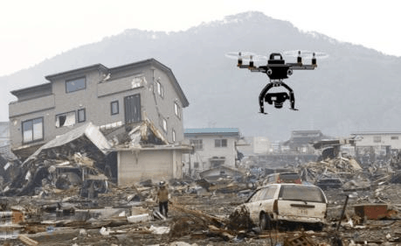
HUMAN IDENTIFICATION IN NATURAL DISASTERS
PRESENTED BY:
18UK1A05D6 - Jakkoju shruthi 18UK1A0590 - Muzaffar Hussain khan 18UK1A05E6 - Kokkirala akshitha 18UK1A05A4 - Rudroju sathish

Slide 2
OUTLINE
INTRODUCTION
OBJECTIVE
PROPOSED SOLUTION
TOOLS
TECHNICAL ARCHITECTURE
PREPROCESSING AND FLASKINTEGRATION
FINAL OUTPUT
FUTURE SCOPE
CONCLUSION

Slide 3
INTRODUCTION
A natural disaster is a major adverse event resulting from natural processes of the Earth; examples are floods, hurricanes, tornadoes, volcanic eruptions, earthquakes, tsunamis, and other geologic processes.
According to the statistics, 68% of India’s land is prone to drought, 60% to earthquakes, 12% to floods and 8% to cyclones, making India one of the most disaster-prone countries in the world, affecting overall 85% of Indian land and more than 50 million people.

Slide 4
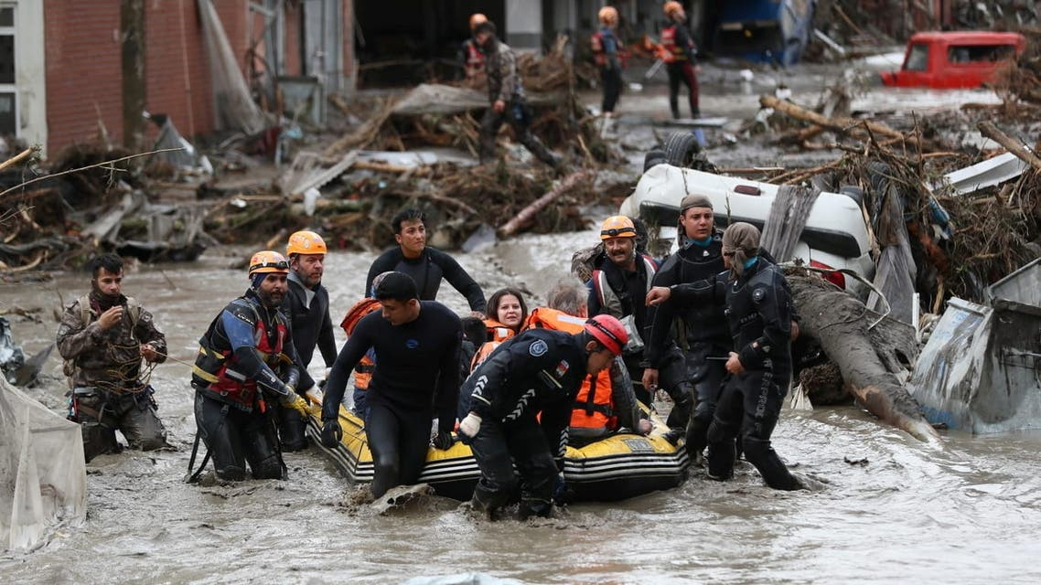
OBJECTIVE
After the natural disaster happens the rescue team will go to that place to help the people but during such a disaster there will be places where humans cannot go and identify people to deliver help, by the time they identify them the person might lose his life. So to easily identify the places where people are there and rescue them quickly, a human and location of the human identification application can be developed.

Slide 5
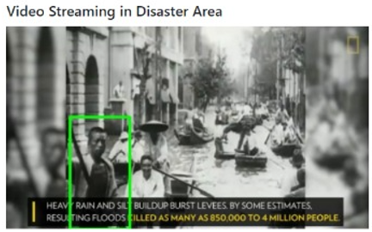
PROPOSED SOLUTION
The aim is to build application that can detect people when it is streamed from a drone that is integrated with a camera. For instance, we build a web application that is used to detect people from a recorded video of a disaster-affected area. When people are detected in the video stream the images are stored in local storage and their current location is captured and stored locally in the application and the count of people which were detected is sent to the authorized people.

Slide 6
TOOLS
Anaconda Prompt
Packages : open-cv python “For image processing and computer vision tasks”
Imutils “For image processing functions like resizing”
Geopy “For locating the addresses”
Spyder IDE

Slide 7
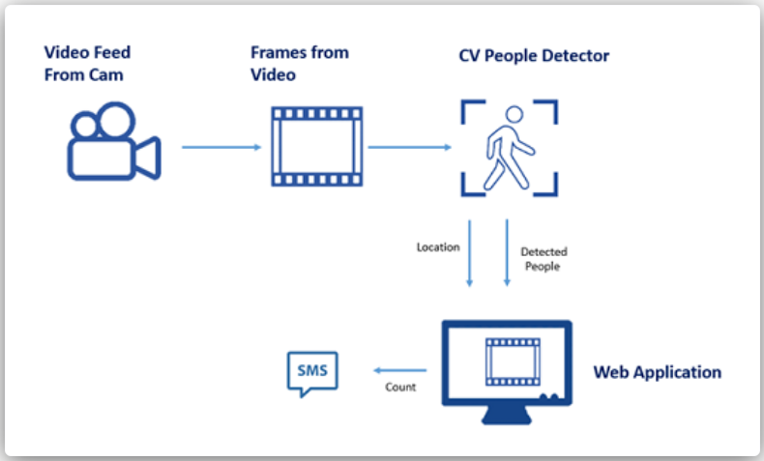
TECHNICAL ARCHITECTURE

Slide 8
PREPROCESSING AND FLASK INTEGRATION
Initialize our person detector. First, we make a call to hog = cv2.HOGDescriptor() which initializes the Histogram of Oriented Gradients descriptor.
Then, we call the setSVMDetector to set the Support Vector Machine to be pre-trained person detector, loaded via the cv2.HOGDescriptor_getDefaultPeopleDetector() function.
At this point our OpenCV person detector is fully loaded, we just need to apply it to some images.
Along with that, we initialize geolocator and flask and video capture to capture video from the local file

Slide 9
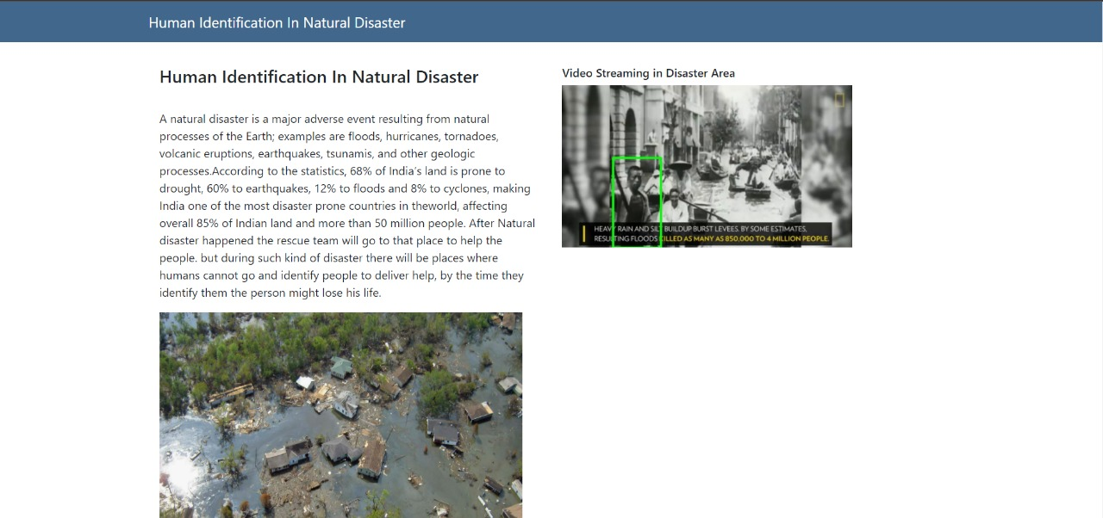
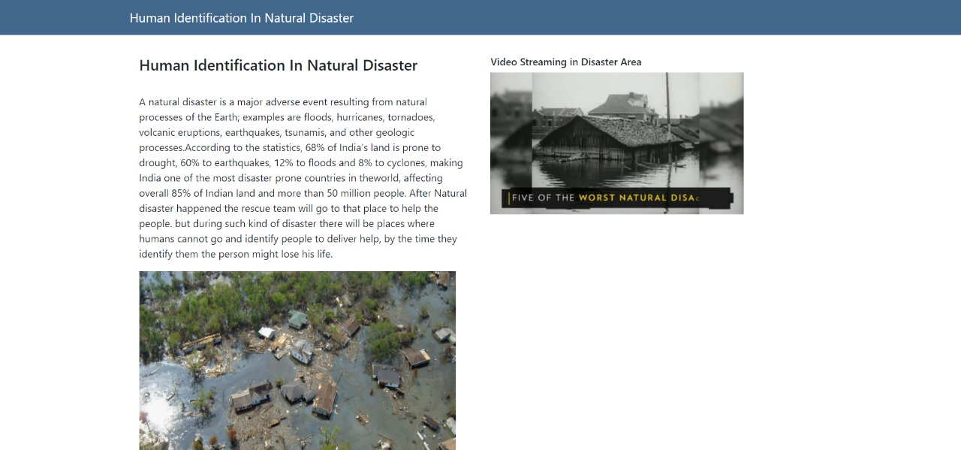
FINAL OUTPUT

Slide 10
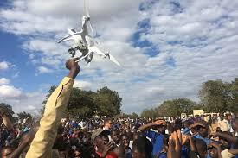
FUTURE SCOPE
In the future, during disasters, drones can be used for capturing the images and location of the victims using a highly focused camera with high megapixels. Also, the accuracy and effectiveness of the working of the software application can be increased by working with computers with high computational capacity.

Slide 11
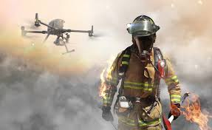
CONCLUSION
Computer vision methods have been proposed for detecting victims from the camera of a robotic platform and these methods all have roots in the more general field of automatic human detection.

Slide 12
THANKYOU!!

